Slide 1

CHAT FUNCTION
Individual and Group Chat

Slide 2
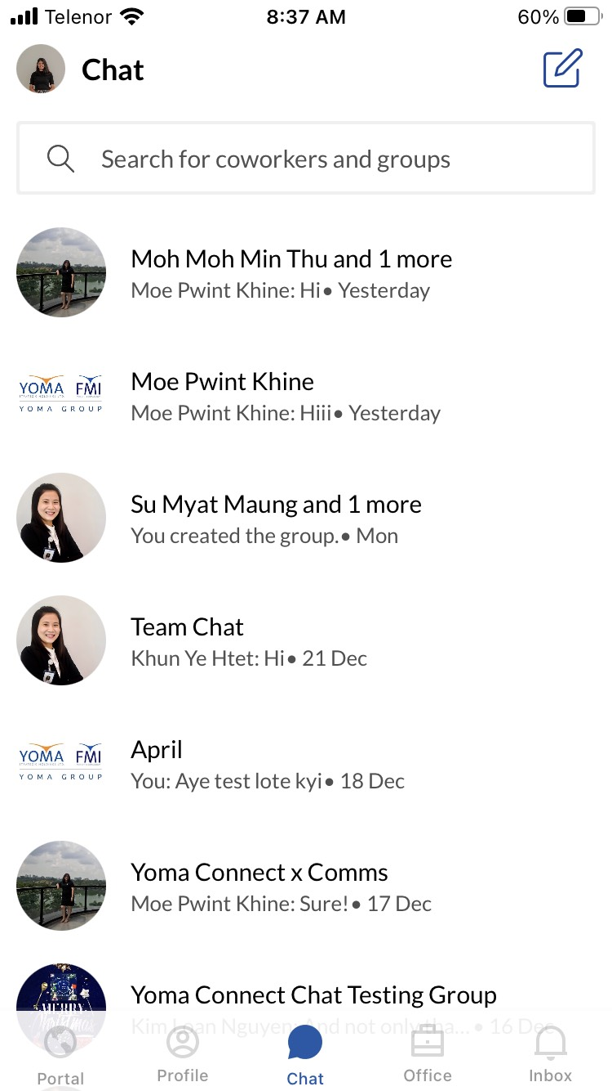
Where to look for Chat function on
Yoma Connect App?
Login to your Yoma Connect App on your mobile.
Click on the icon on the bottom of the application.

Slide 3
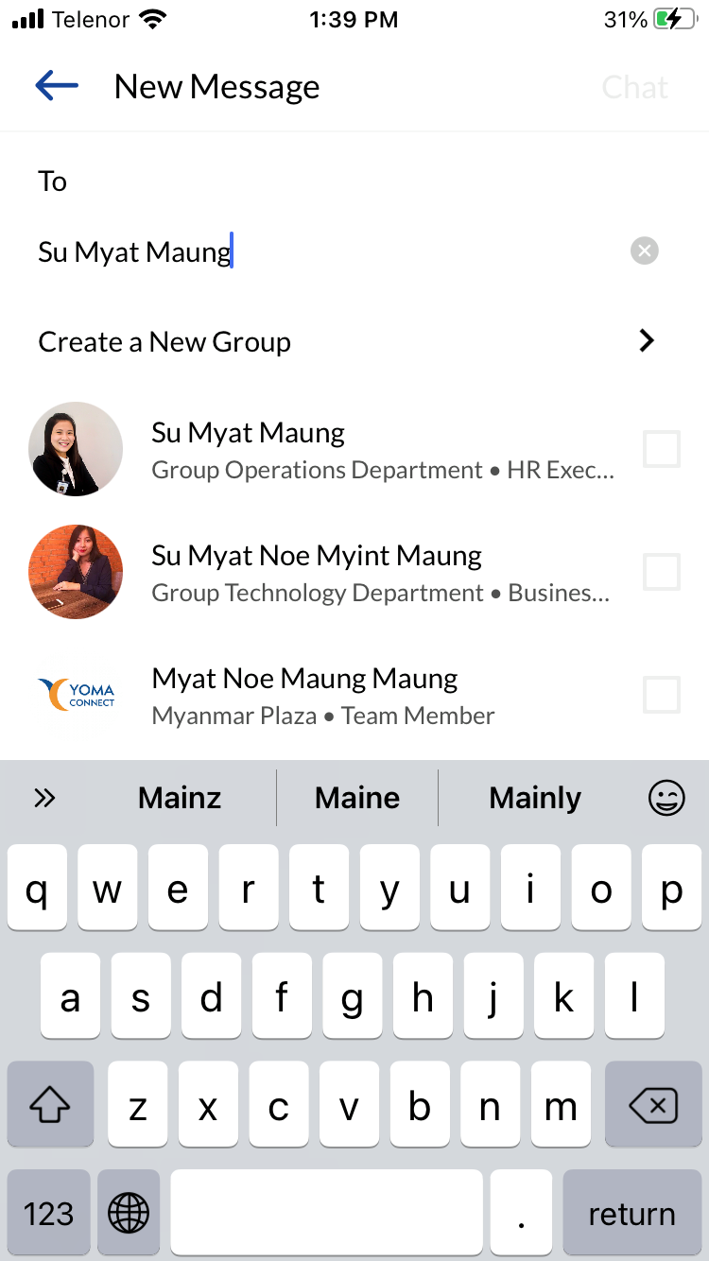
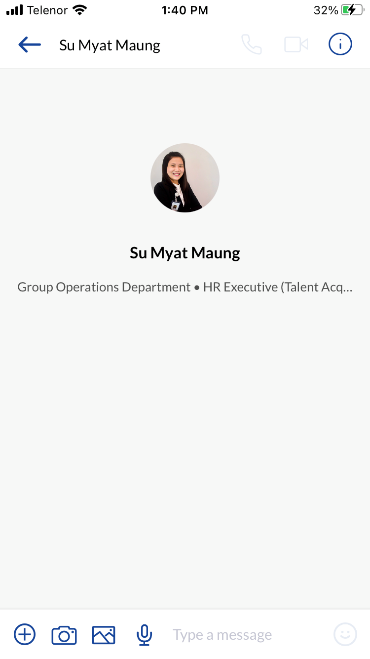
Starting a conversation with a coworker
1
Click on the icon on the top right corner to start the new conversation.
Type coworker name.
Start a conversation on individual chat box.
2
3

Slide 4
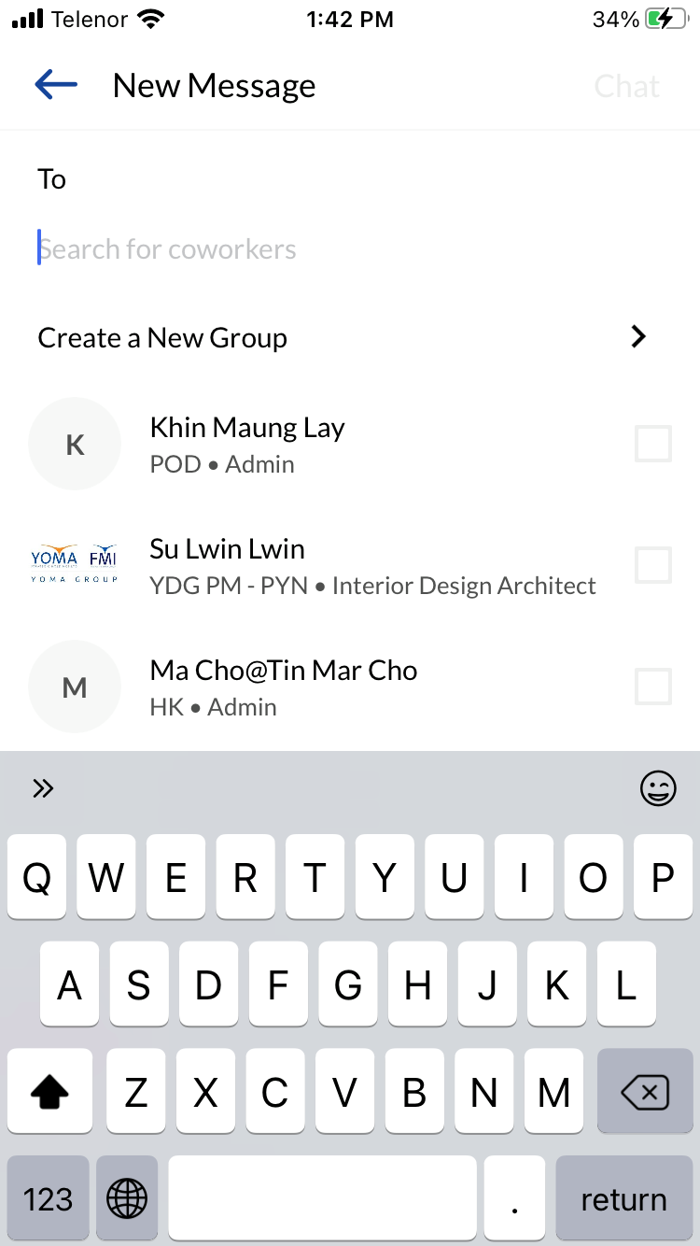
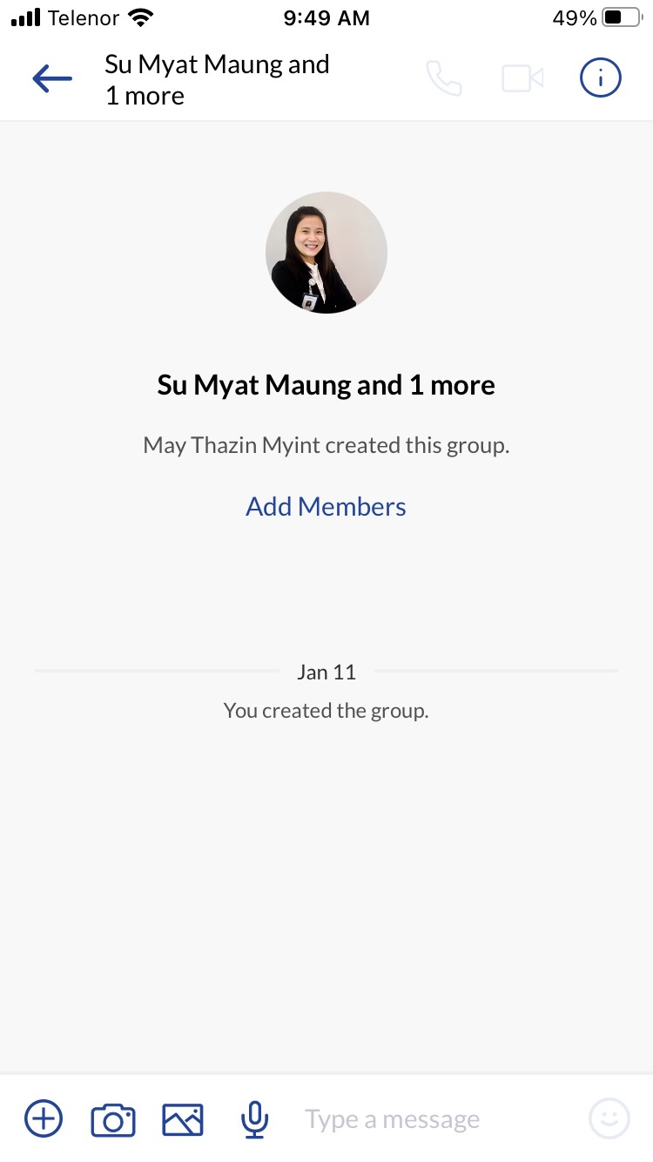
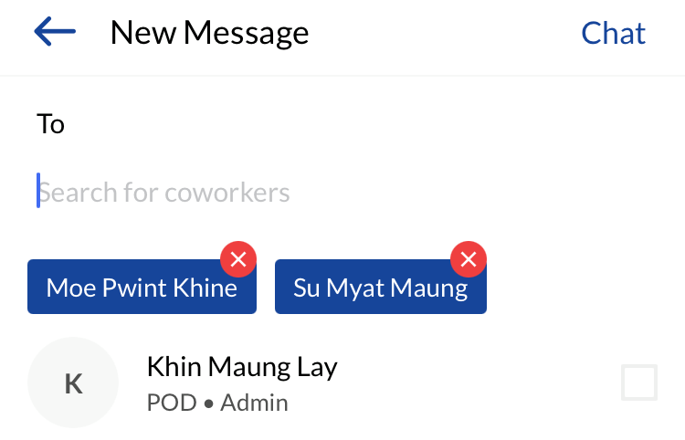
Creating
Group Chat box
1
2
Click on the icon on the top right corner to start the new conversation.
Click on “Create a New Group”.
Type coworker names to add into the group.
Start a conversation in the Group Chat box.
3
4

Slide 5
Adding more coworker in the existing Group Chat
Go to the existing Group Chat you wish to add new coworker.
Click on “Add Members”.
Type coworker name to add in the existing Group Chat.

Slide 6
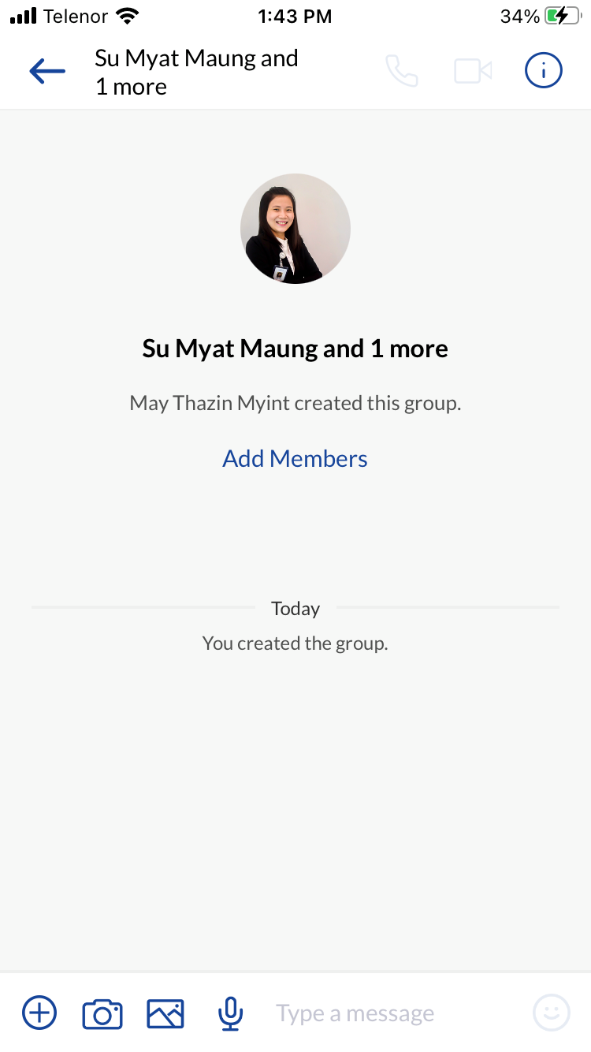
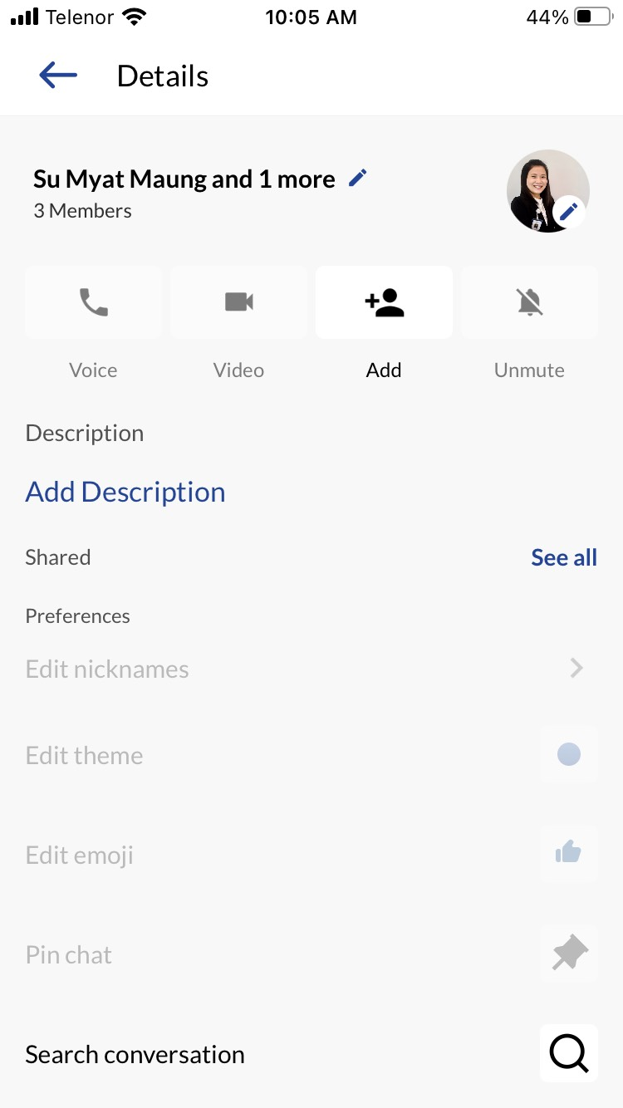
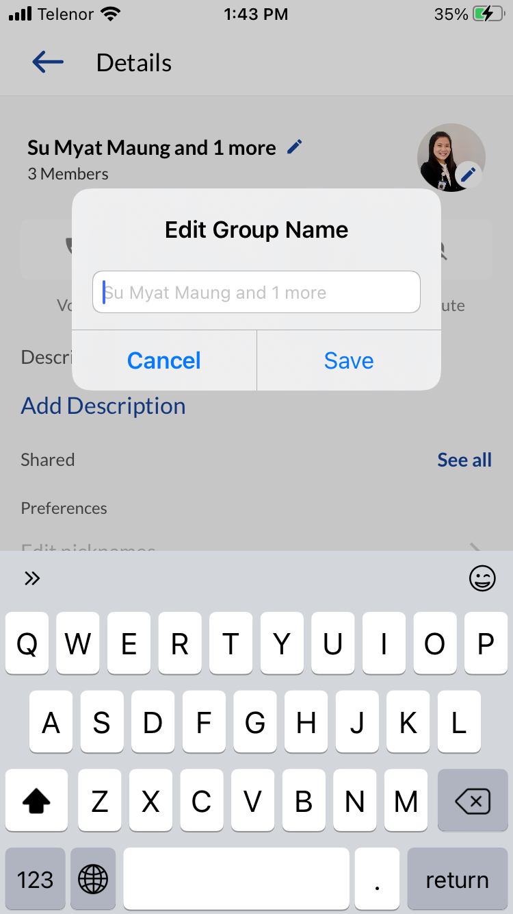
Changing Group Chat name
1
2
Click on the icon on the Group Chat box.
Click on the icon to edit the Group Chat name.
Type Group Chat Name and click “Save”.
3

